Slide 1
Weekly Meal Planner
&
Grocery Generator
A Java console program
- - - - - - - - - - - - - - - - - - - - - - - - - - -
PRESENTED BY:
Sai Srinidhi -2620030217
R.Dakshitha-2620080004
- - - - - - - - - - - - - - - - - - - - - - - - - - -

Slide 2
ABSTRACT:
Planning weekly meals and tracking raw grocery items manually is time-consuming, budget limit, and prone to errors. A lightweight Java console application that automates weekly menu customization and grocery list generation.
  Plan breakfast, lunch and dinner for every day of the week.
  Arrays store the days, meal options.
  Loops and switch-case drive the menu and ingredient logic.
  Ternary and logical operators validate each input.
  Ends with a complete grocery list for the chosen meals.

Slide 3
INTRODUCTION:
7-day meal organization and shopping preparation. Meal planning is an essential part of everyday life, helping individuals and families save time, reduce stress, and maintain a balanced diet. Traditionally, meal planning is done manually, which can be repetitive, error-prone, and inconvenient.
  Allows users to select meals for each day of the week.
  Automatically generates a weekly meal plan.
  Produces a grocery list based on chosen meals.
  This highlights the practical use of arrays, loops, conditional statements, and user input handling in Java.

Slide 4
EXISTING:
Describes the current/manual way of doing things (meal planning without automation).
  Manual meal planning (time-consuming, prone to errors).
  Grocery shopping becomes inefficient because ingredients are not mapped to meals in advance.
  No automatic grocery list generation.
  Limited flexibility in tracking weekly meals.
  No default options are suggested when a person forgets to choose.
  Users must manually prepare a list, which can lead to missing items or duplicates.

Slide 5
PROPOSED:
Describes the new approach you are suggesting (our program), which solves the problems of the existing system.
  Operators: Ternary operator for default choices, logical & relational operators for validation.
  Control Statements: For loops for iteration, Switch for ingredient mapping.
  Arrays: To store days, meal options, and final selections.
  Format Specifiers: For neat console output.

Slide 6
CO ATTAINMENTS:
CO-1 :
Operators (Arithmetic, Relational, Logical, Ternary), Scanner class, Format Specifiers.
CO-2:
Conditional Statements (Switch case), Loops (For loop).
CO-3:
Arrays(1-D).

Slide 7
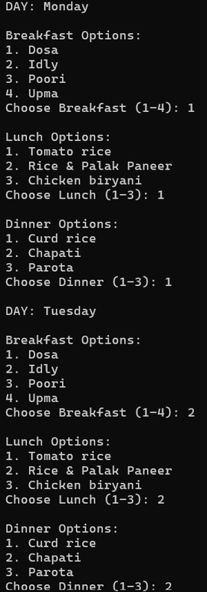
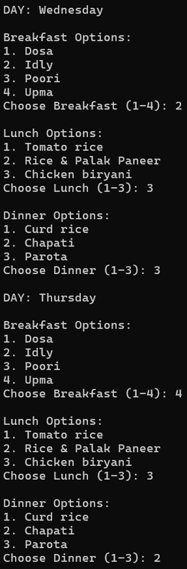
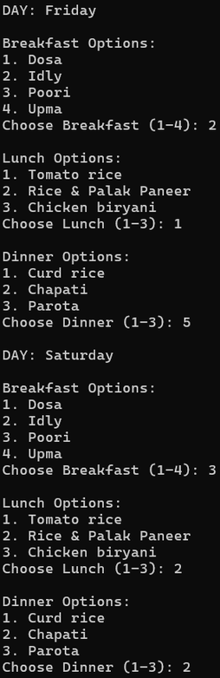
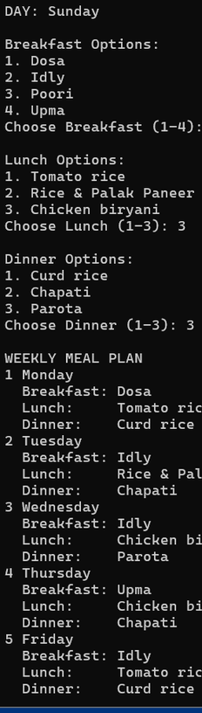
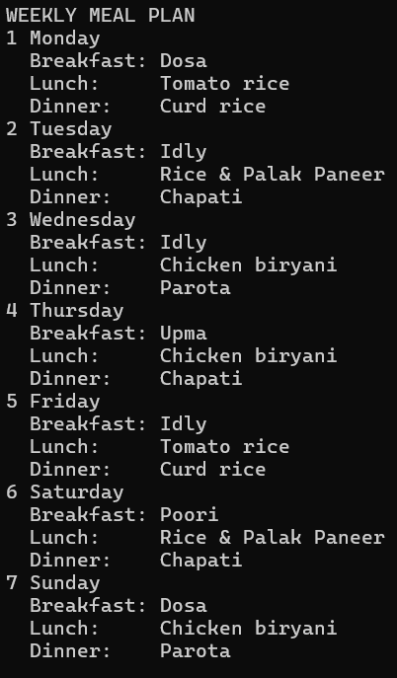
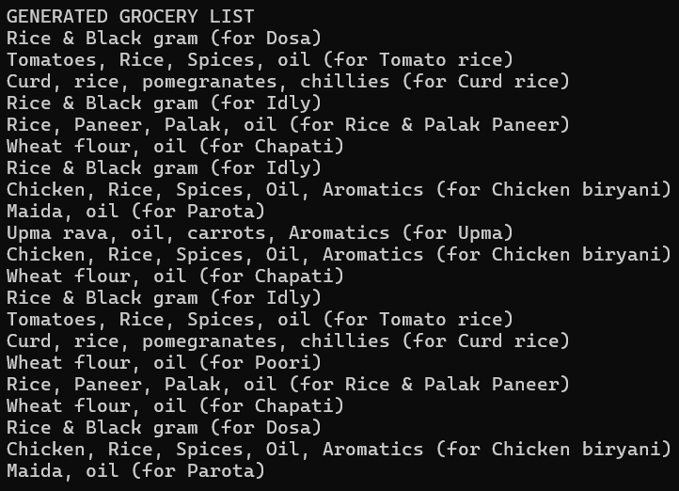
OUTPUT:

Slide 8
THANK YOU

